Slide 1
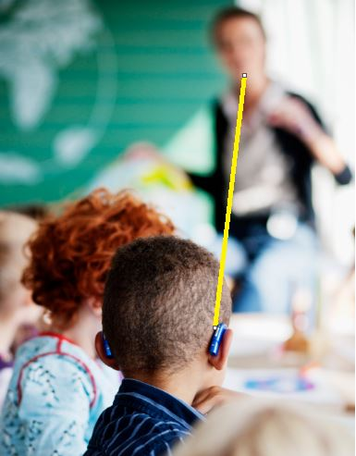
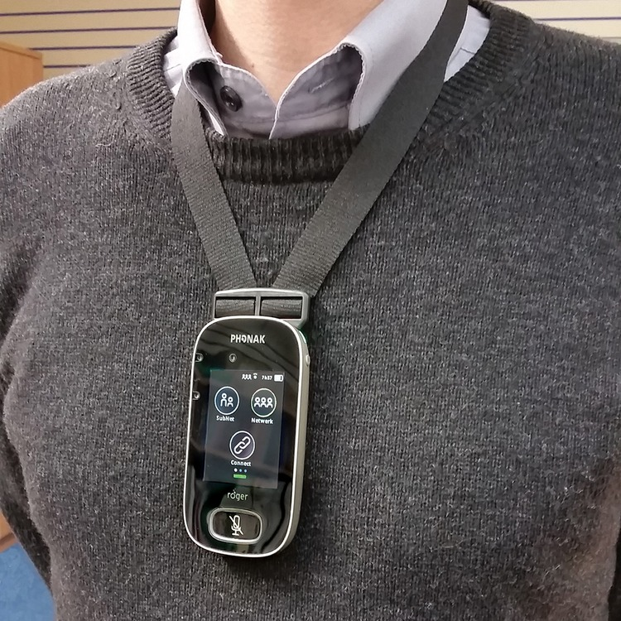
Your Student’s FM System
A quick and simple reference to using a Touch Screen FM System

Slide 2

What is an FM system?
An FM system is a wireless system designed to help someone better identify and understand speech in noisy situations and over distances of up to 15 meters (50 feet). Some FM systems work together with hearing aids.
It transfers the speaker’s voice right into the hearing aids of your student.
The FM system has 2 main parts: the transmitter and the receivers.

Slide 3
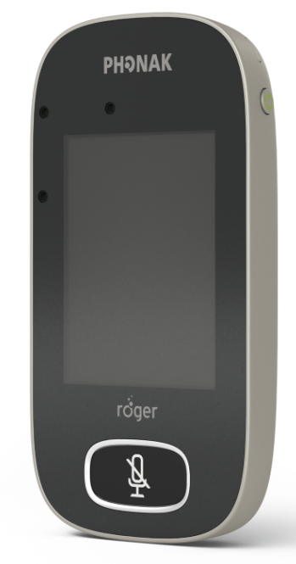
Parts of the FM
On/Off Button
These dots are the microphone.
This FM system is touch screen. Most of the features are accessible by clicking through the menu.
Mute and unmute button
NOTE: There is a lanyard attached to this device. It is to be worn around your neck since the microphones are on the device

Slide 4
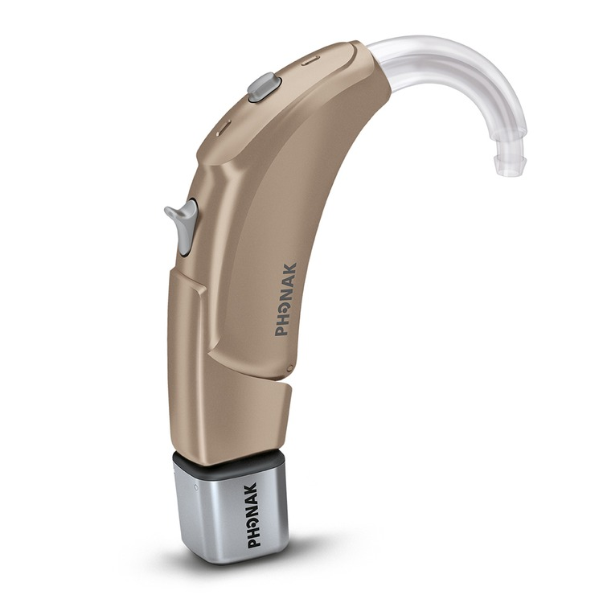
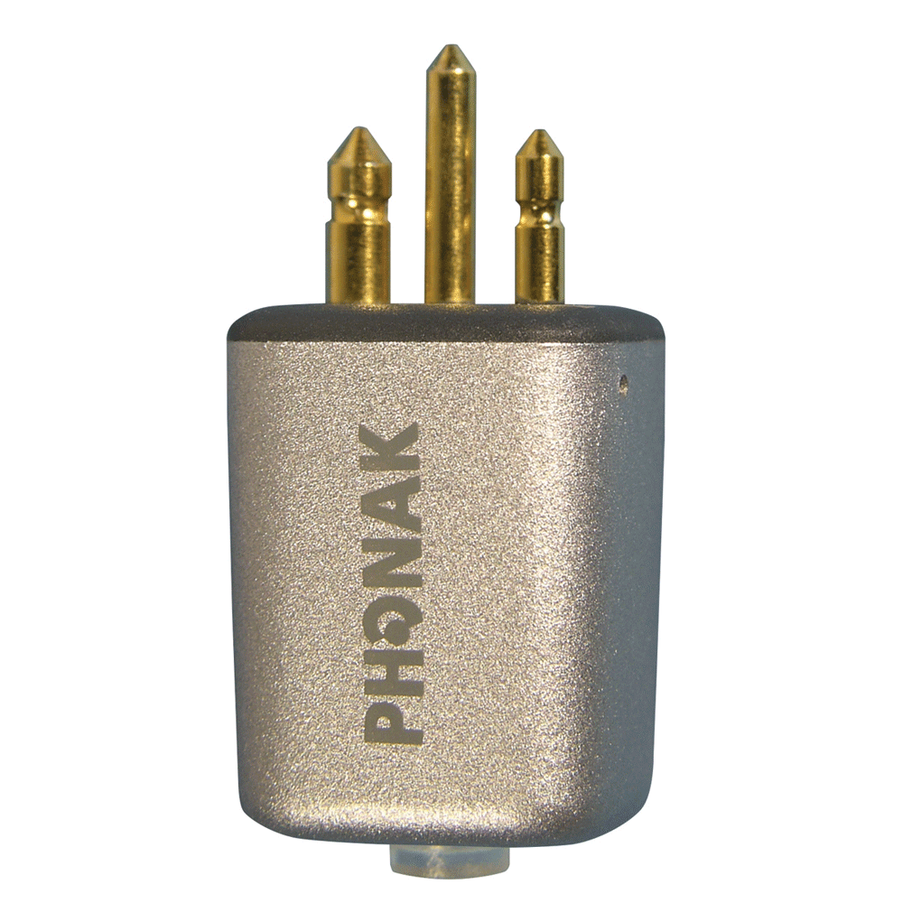
Parts of the FM (2)
The receivers (AKA boots)
This part attaches to the student’s hearing aids. They will attach and detach this piece at the beginning and end of every school day.

Slide 5
What do I need to know?
~Turning the system on and off with the “On/Off” button listed on the previous slide, hold this button in until the screen lights up.
~Muting the system when you are not instructing or talking to the student using the button at the bottom of the device
~Unmuting the system when you are instructing of talking to the student by hitting the button again at the bottom of device

Slide 6
Tips for success
ALWAYS have the microphone holes uncovered and near your mouth
If you are wearing chunky necklaces, scarves, etc. make sure that they are not making noise that could be picked up by the microphone.

Slide 7
What happens if my student has a problem with their FM or hearing aids?
Email or call me!
In most cases, I will provide some suggestions for you to try. If equipment still isn’t working properly, I will plan to meet to take care of the issue within a day or two.
My contact information:
Phone: (412)-443-4338
Email: tmarquardt@northallegheny.org

